Slide 1
Electoral Area D/Rural Grand Forks
Five-Year Financial Plan 2025-2029

Slide 2

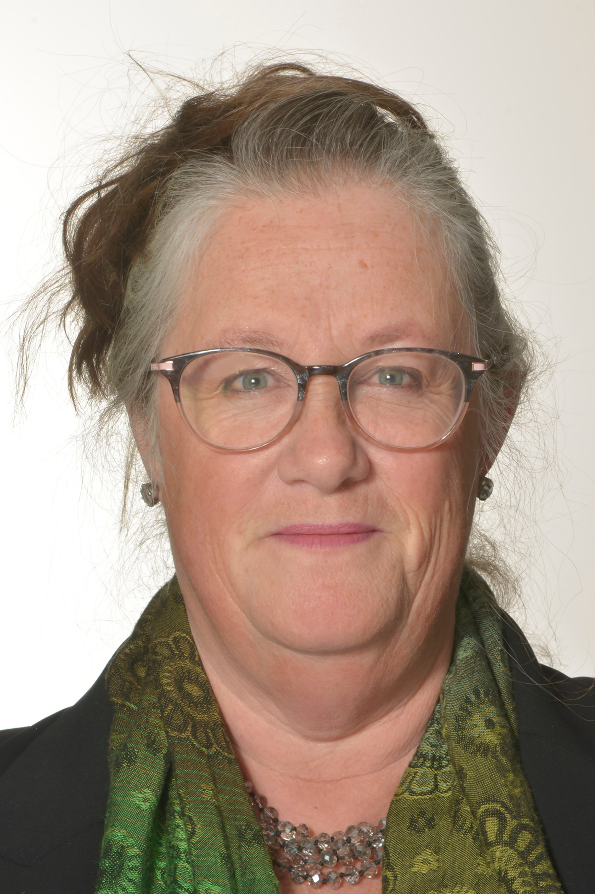
IN THE SPIRIT OF RESPECT, TRUTH AND RECONCILIATION, WE HONOUR AND THANK THE INDIGENOUS PEOPLES ON WHOSE TRADITIONAL AND UNCEDED LANDS WE OPERATE
Director Linda Kay Wiese
WELCOME! WE’RE GLAD YOU ARE HERE

Slide 3

Tonight‘s program
& list of presenters
Welcome & land acknowledgement
Director Wiese
Introductions
Mark Andison, CAO
RDKB 2025-2029 Budget & Financial Plan
Farhad Hossain, CFO
World Café
Ask Questions of Director and Staff
Thank you, draw prize and goodnight
Director Wiese

Slide 4
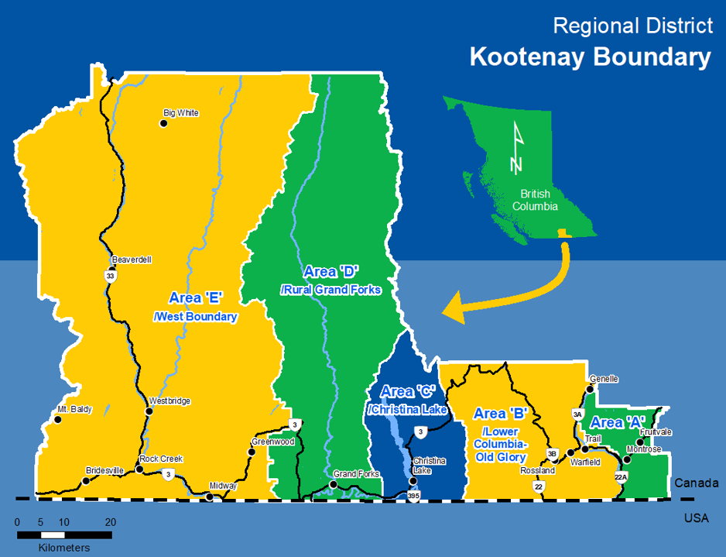
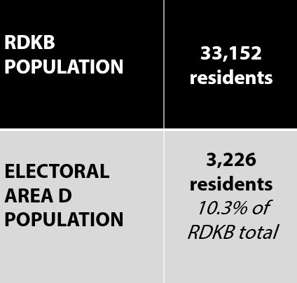

Slide 5

LET’S TALK BUDGET
2025

Slide 6
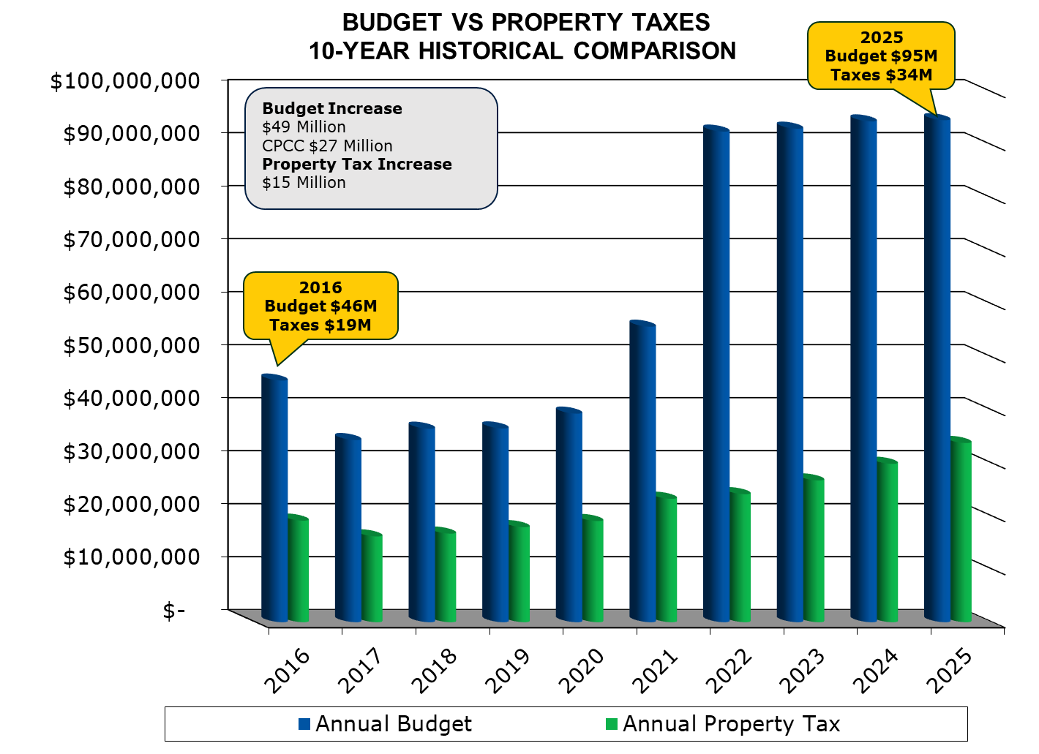

Slide 7

2025 ELECTORAL AREA ‘D’
REQUISITION (PROPOSED)

Slide 8

2025 ELECTORAL AREA ‘D’
Property Tax / $100,000

Slide 9
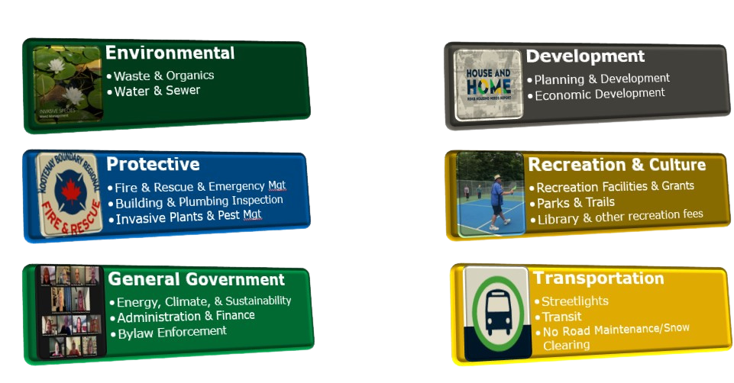
FINANCIAL STATEMENT SERVICE CATEGORIES

Slide 10
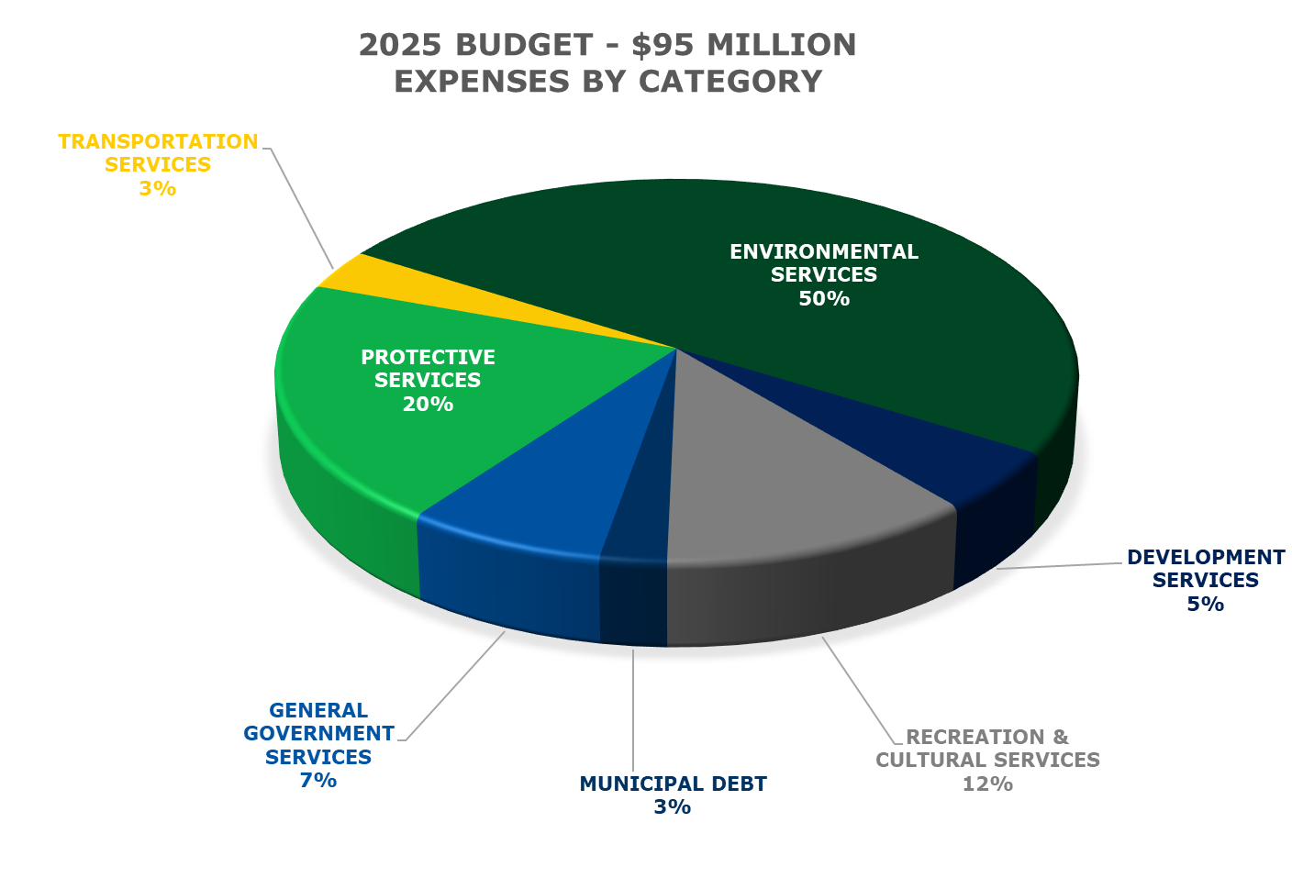

Slide 11
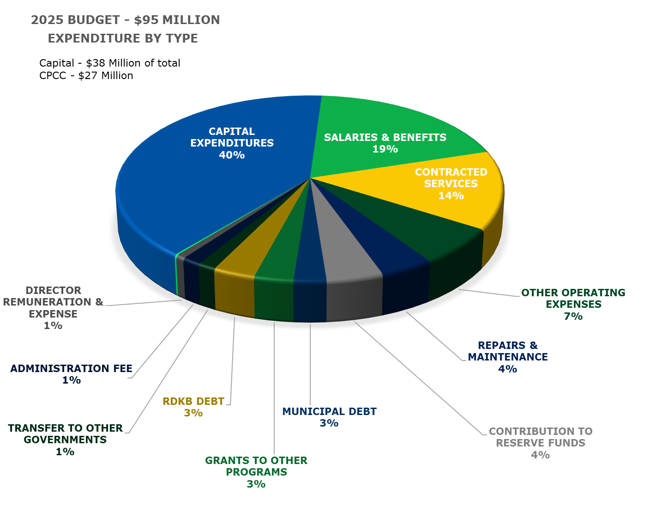

Slide 12
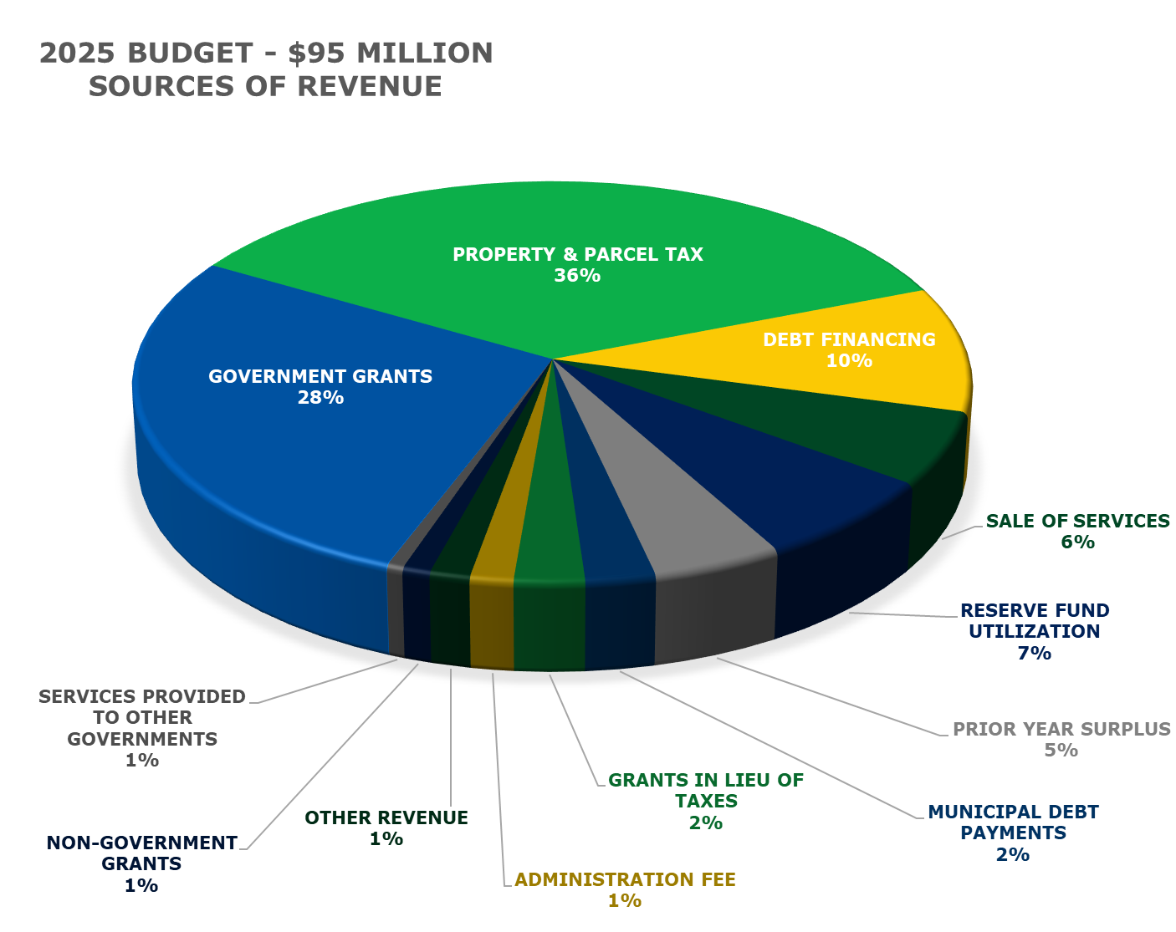

Slide 13
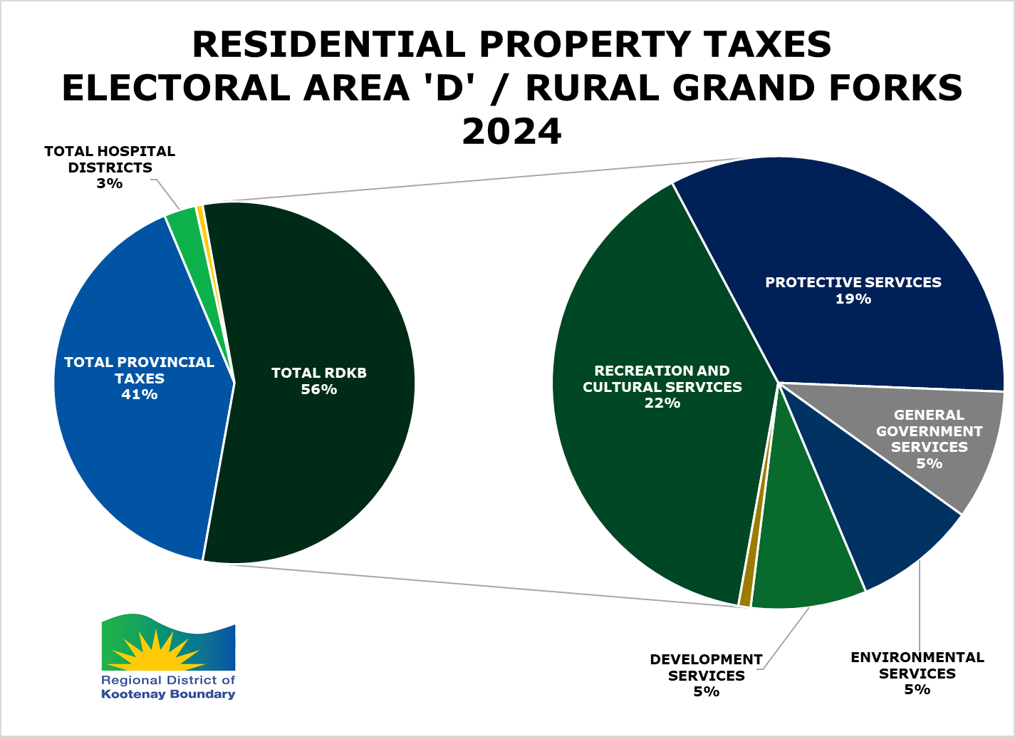

Slide 14

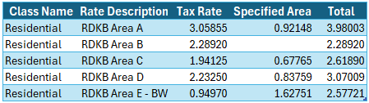
2024 Tax Rate Comparison
Source: https://www2.gov.bc.ca/gov/content/taxes/property-taxes/annual-property-tax/tax-notice/tax-rates
Area A & Area B Parcel Tax are not included in figures

Slide 15


AREA D/RURAL GRAND FORKS
WORLD CAFE
CHAT WITH YOUR DIRECTOR
ASK THE STAFF

Slide 16

TABLE
01
TABLE
02
TABLE
03
Budget & Financial Plan:
Farhad Hossain, CFO
RDKB HomeSmart:
Freya Phillips, Senior Energy Specialist
FireSmart & Emergency Management:
Mark Stephens, Manager of Emergency Programs & Carlene Pires, Emergency Program Coordinator
TABLE
04
TABLE
05
TABLE
06
TABLE
07
Transit/ Food Hub/ Bylaw Enforcement/Building Inspection/ Economic Development:
James Chandler, GM of Operations
Floodplain Mapping/
Watershed & Drought Plans:
Kristina Anderson, Watershed Planner &
Donna Dean, Manager of Planning & Development
Recreation:
Paul Keys, Manager of Facilities and Recreation
Invasive Plants/
Mosquitoes & Waste Management:
Janine Dougall, GM Environmental Services

Slide 17

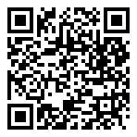
Connect with Linda Kay:
Thank you!
We Appreciate Your Feedback
Website
rdkb.com/Regional-Government/Town-Halls
Connect with YOUR Director Linda Kay: areaddirector@rdkb.com

